Slide 1







Enterprise Blockchain Developers (Intermediate)
In support of
Powered By

Slide 2
Outline
Create a React App
© 2017-2020 SmartMesh Foundation Pte. Ltd. | MeshBox Foundation Pte. Ltd.

Slide 3
MVC Code Demo Requirements: Registration
Requirements:
1. Design database models: Using SQLite3
2. Write Login, Logout, and Dashboard home page
3. Write controller to interact with database through Models and rendering views
Code Demo Now
How to write a program from scratch

Slide 4
MVC Code Demo Requirements: Registration
tasks:
1. add views to the program
2. make the views into reuseable parts
3. connect routes and controller to the views (connect contract view to its router)
controller pass params down to the view
4. test Form data submition using login page form
create form data handler and its route
5. test JWT token with postman
6. add auth to all routes except login page itself
7. connect login frontpage with api
8. add fileupload function: routes and controller

Slide 5
MVC Model
Model
The central component of the pattern. It is the application's dynamic data structure, independent of the user interface.[5] It directly manages the data, logic and rules of the application.
View
Any representation of information such as a chart, diagram or table. Multiple views of the same information are possible, such as a bar chart for management and a tabular view for accountants.
Controller
Accepts input and converts it to commands for the model or view

Slide 6
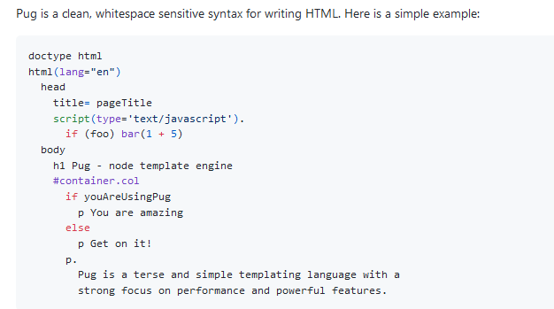
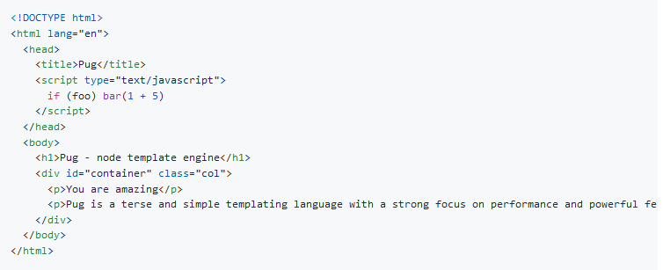
Views: Templates
Pug formly named Jade

Slide 7
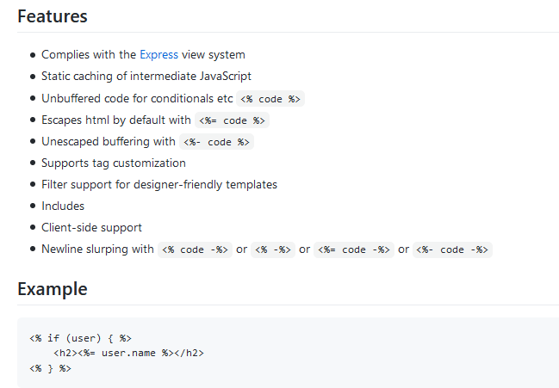
Views: Templates
EJS: html + code https://github.com/tj/ejs

Slide 8
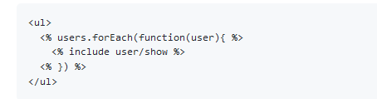
Views: Templates
EJS: includes
makeing html managable

Slide 9
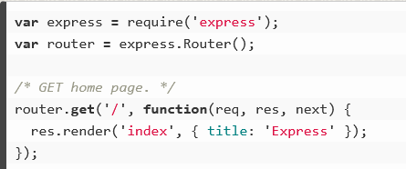
Views: Pass Parameters down to the View
Code Demo: pass params
Code Demo: check login logic

Slide 10
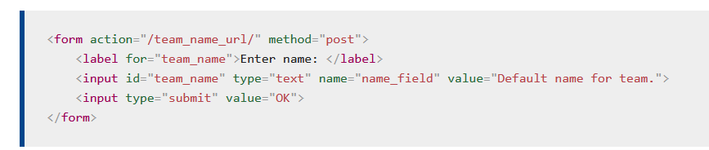
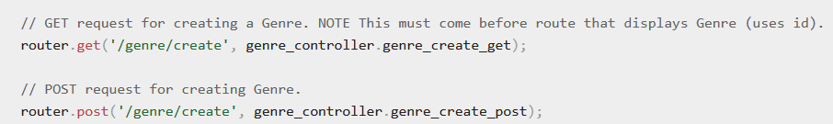
Form
1 specify Router
2 specify the request type, usually POST for Forms
Form will take inputs value as parameters to send to the server
action should match routes, then the route will call the controller function to handle the request. In this case, put action = /genre/create

Slide 11
How to use JWT on client side
get the token from api
1. store it in cookie (demo this method)
2. store it in localstore
Difference
Local Storage
Pros: It's convenient.
Cons: It's vulnerable to XSS attacks.
Cookies
Pros: The cookie is not accessible via JavaScript; hence, it is not as vulnerable to XSS attacks as localStorage.
Cons: Depending on the use case, you might not be able to store your tokens in the cookies. For Instance: Cookies have a size limit of 4KB.

Slide 12
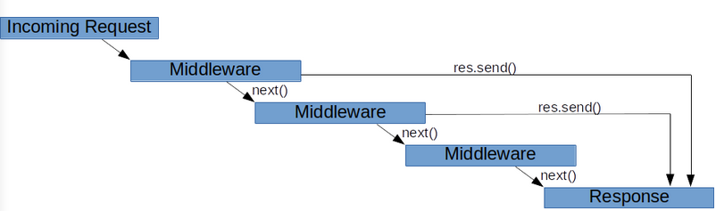
Middleware
demo auth middleware

Slide 13
API vs Non API Application
API doesn't have to pass the params to the view
view coud be written separately
view use js to parse the data
Compare it with a non api program
Data is proccessed in controller and passed down to the view
but view and program cannot be separated

Slide 14
File Upload
localhost (code demo)
https://www.geeksforgeeks.org/file-uploading-in-node-js/
ipfs (code demo)
https://docs.ipfs.io/install/ipfs-desktop/#windows
https://medium.com/better-programming/how-to-get-started-with-ipfs-and-node-fa04baec6b3a

